Slide 1
Team A: The A-Team
Ryan Carnation, Ryan Snyder, Tyler Bradley, Aryan Jha

Slide 2
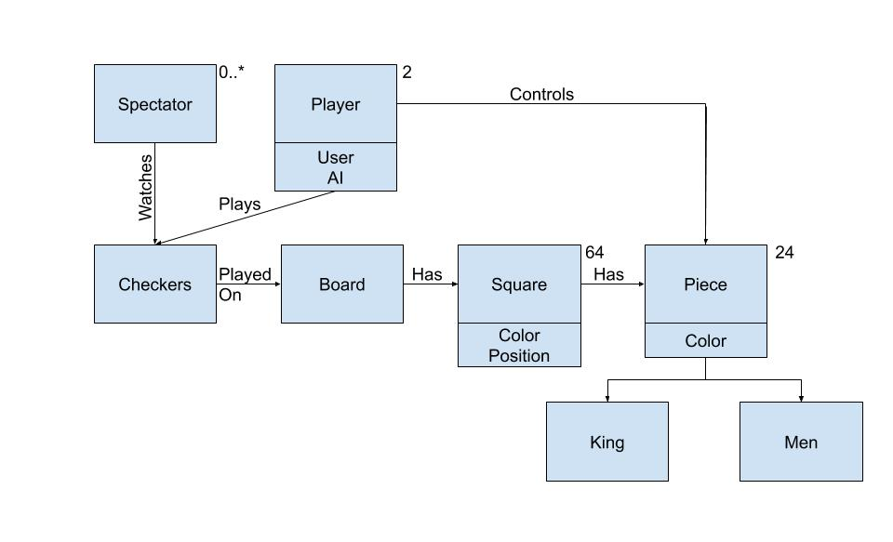
Final Domain Model
Added AI Player and Spectator
AI Player behaves similar to a User Player
Notes:
Talk about what has changed, this includes the AI player and the spectator. Non-technical terms of just how a person uses the website

Slide 3

Application Tier
Manages User Interactions
Holds a PlayerLobby and GameLobby which are responsible for handling Players and Games respectively. Message included here as well, useful for communication.
Notes:
Basic overview of the application tier, talk about basic functionality of each class within this.

Slide 4
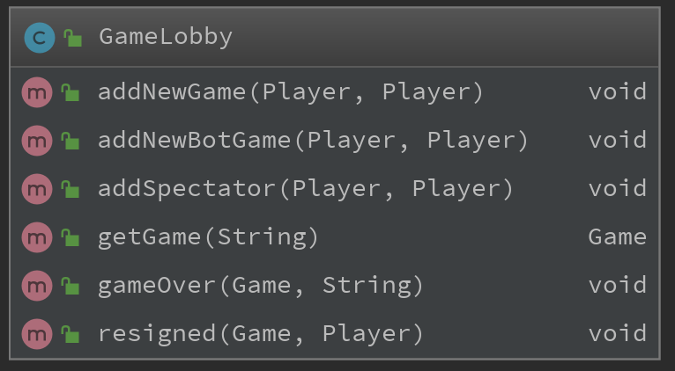
Updates to Application Tier
New methods to add Spectator and AI to a Game
Notes:
To get our enhancements working, we add to have a method to adding the AI to a game with the

Slide 5
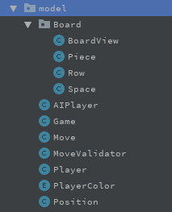
Model Tier
Responsible for Domain Logic
Contains Objects used to create board and handles game logic.
Notes:
Board is contained in the board package duh. Basic idea behind each class in the Model Tier.

Slide 6
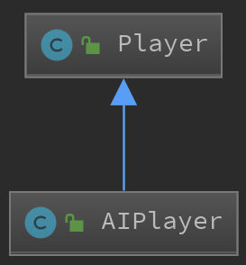
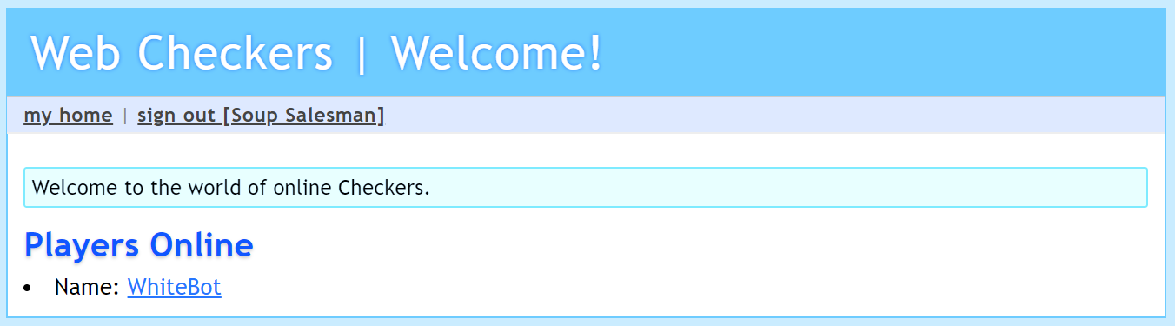
Updates to Model Tier
AIPlayer has been added which extends Player
Notes:
AIPlayer extends Player and has a move function, when it is clicked on the Home page of the application, a new instance of itself is created and it will act like a normal player.

Slide 7
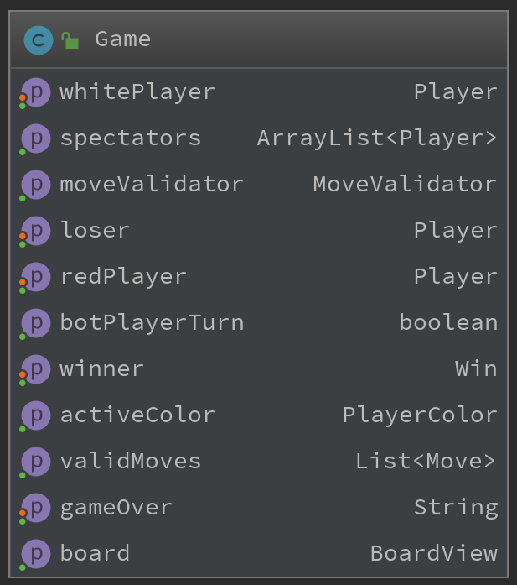
Updates to Model Tier
AddSpectator method added to Game Class, Array of Spectators for each game.

Slide 8
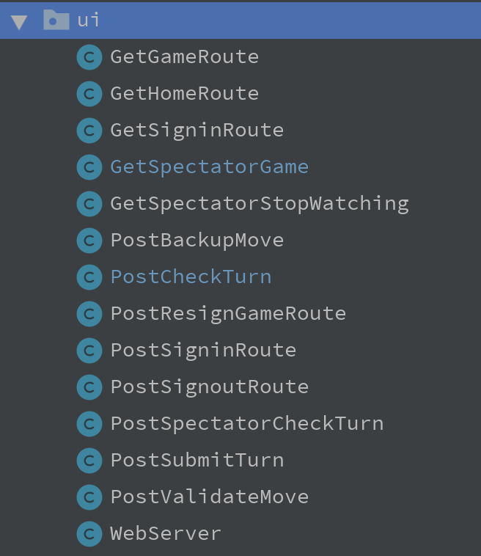
UI Tier
Responsible for handling Get and Post requests sent to and from the server. Control View based on these states

Slide 9
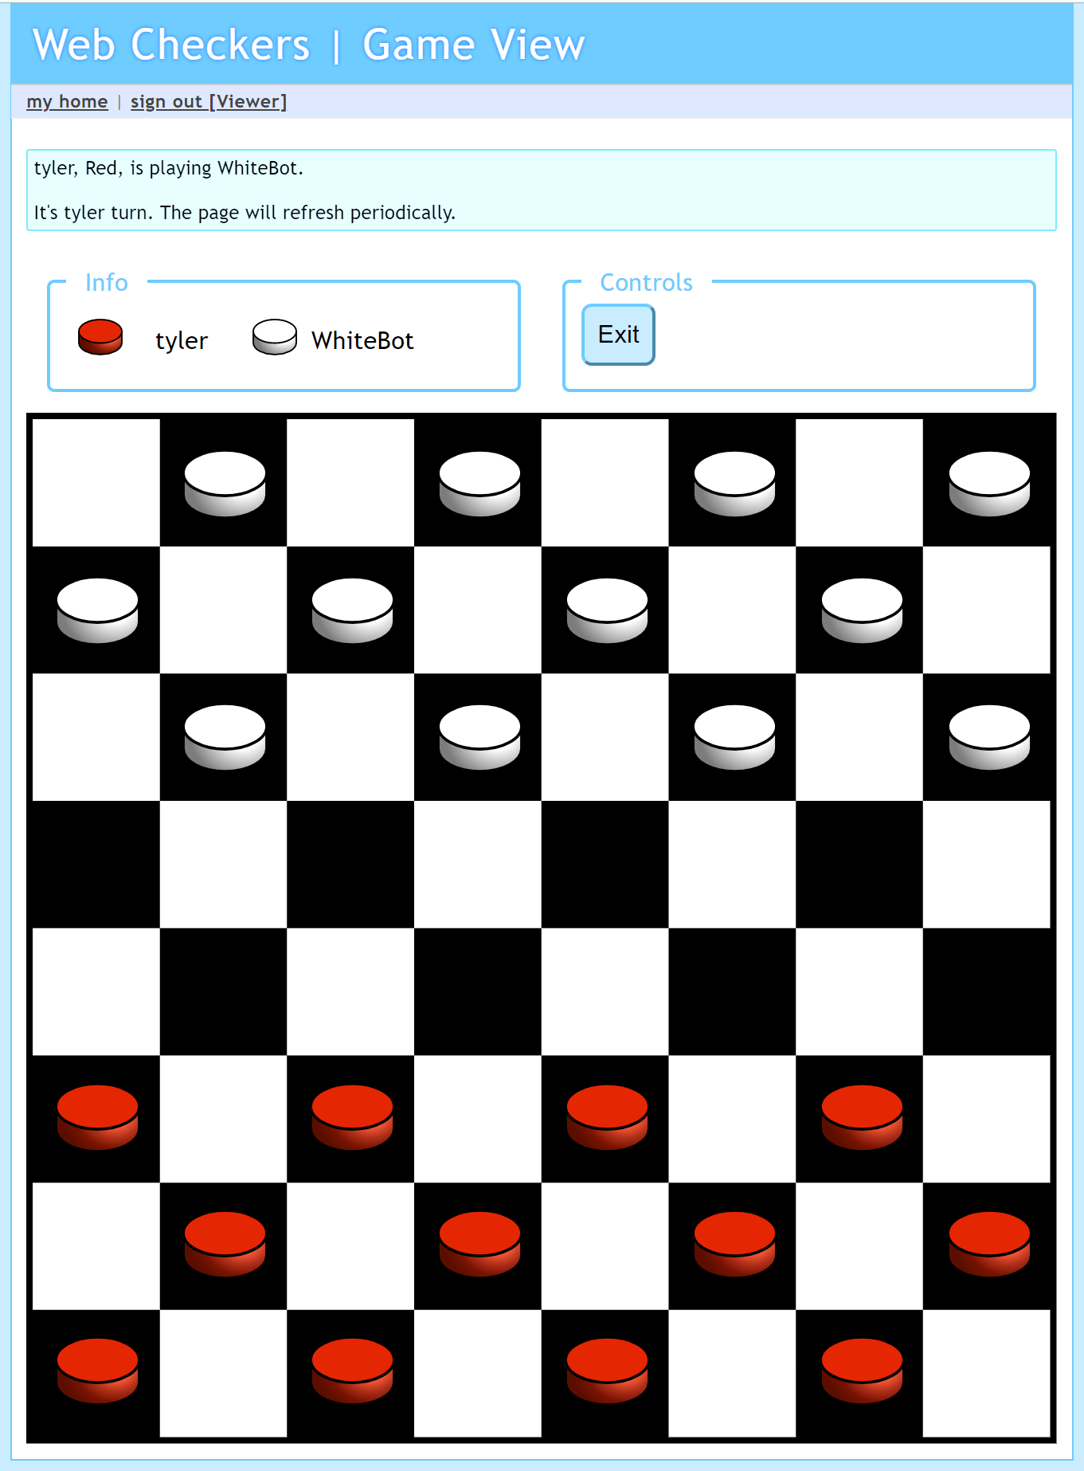
Updates to UI Tier
Get and Post routes added for Spectator Feature
GetSpectatorGame
GetSpectatorGame
GetSpectatorStopWatching
CheckTurn
Notes:
Spectator enhancement had us create additional routes in the UI tier, these routes had to be added to the WebServer.

Slide 10
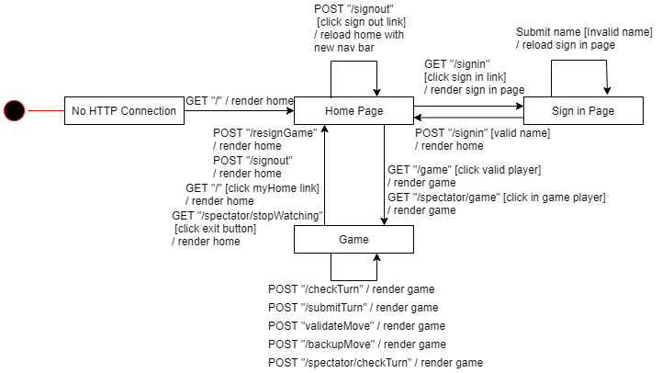
State Chart
Update State chart used in sprint 2 presentation, Need to add additional Get/Post

Slide 11
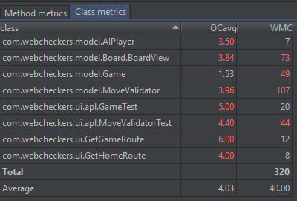
Code Metrics
Notes:
Average operation complexity, weighted method complexity

Slide 12
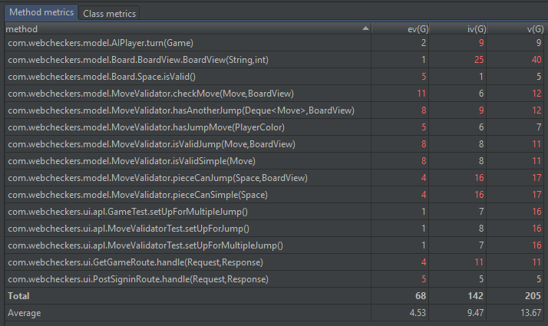
Code Metrics
Notes:
Essential Complexity Metric, Module Design Complexity Metric, Cyclomatic Complexity Metric

Slide 13
Design Improvements
Refactor the way moves are validated
Enhance AI
Better adherence to Object Oriented Design rules
Law of Demeter
Low Coupling and High Cohesion
Reduce logic within Handling methods in UI tier

Slide 14
Future Improvements
Create a list of Games on the Homescreen for Spectator to interact with
Put an indicator on the last moved piece
Add sound effects
Smarter AI
Notes:
Hypothetical Continued Development would see these get changed/fixed/improved. Go over which changes would help increase usability

